Slide 1
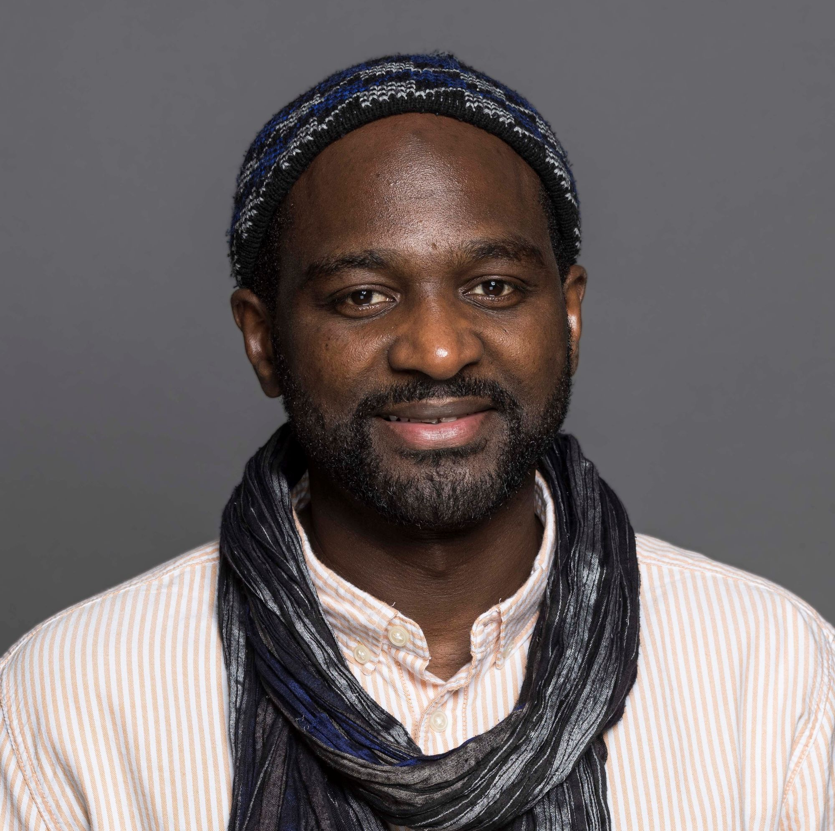
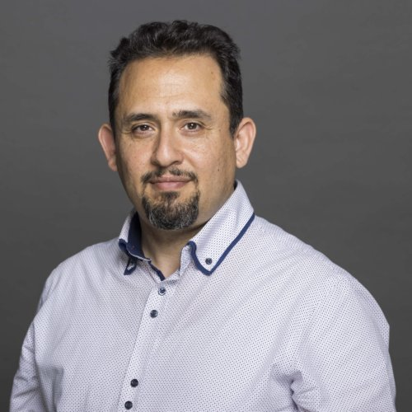
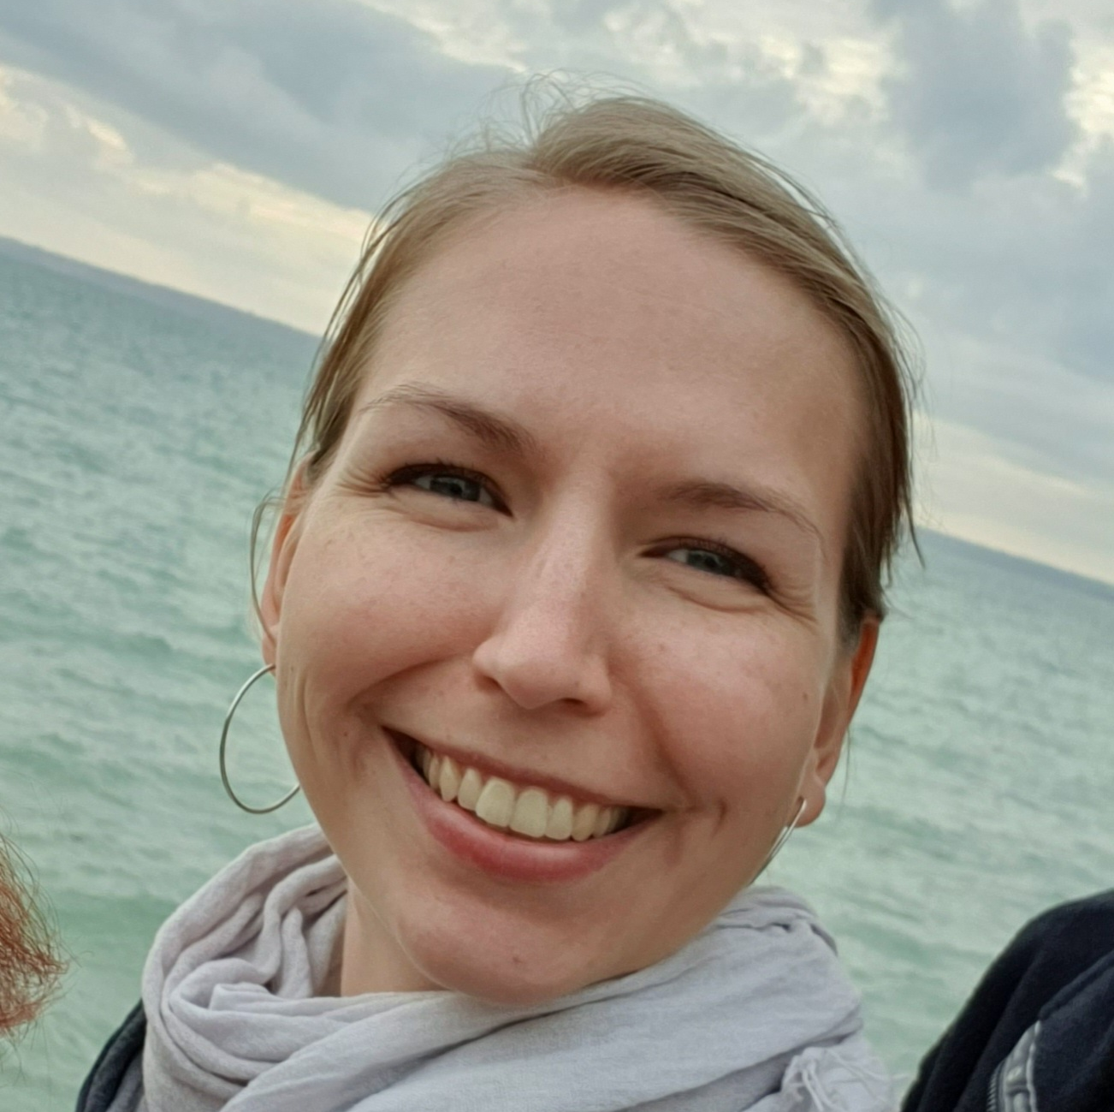
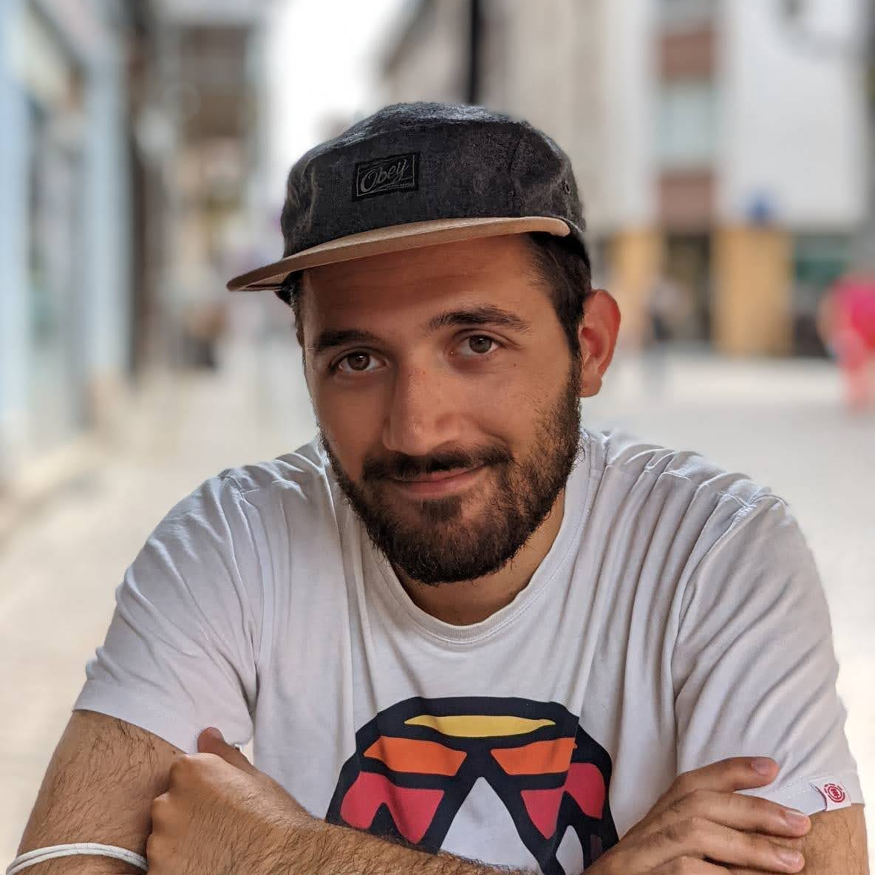
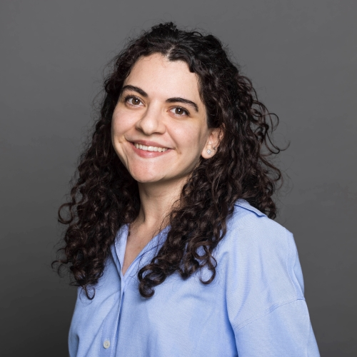
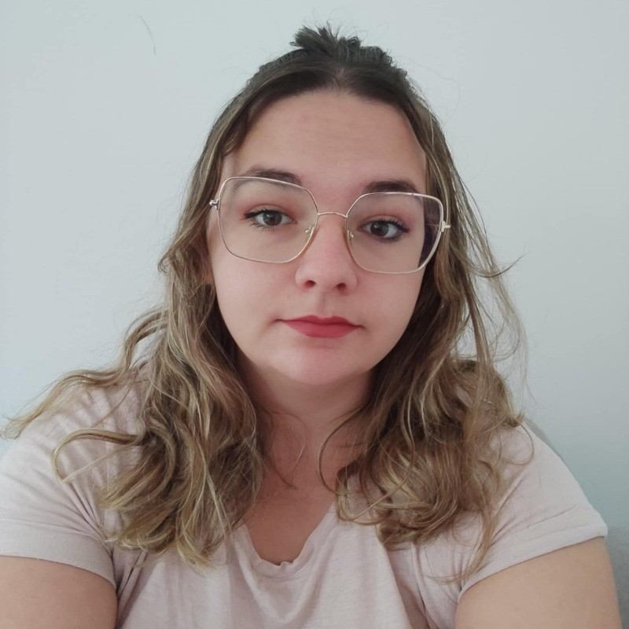
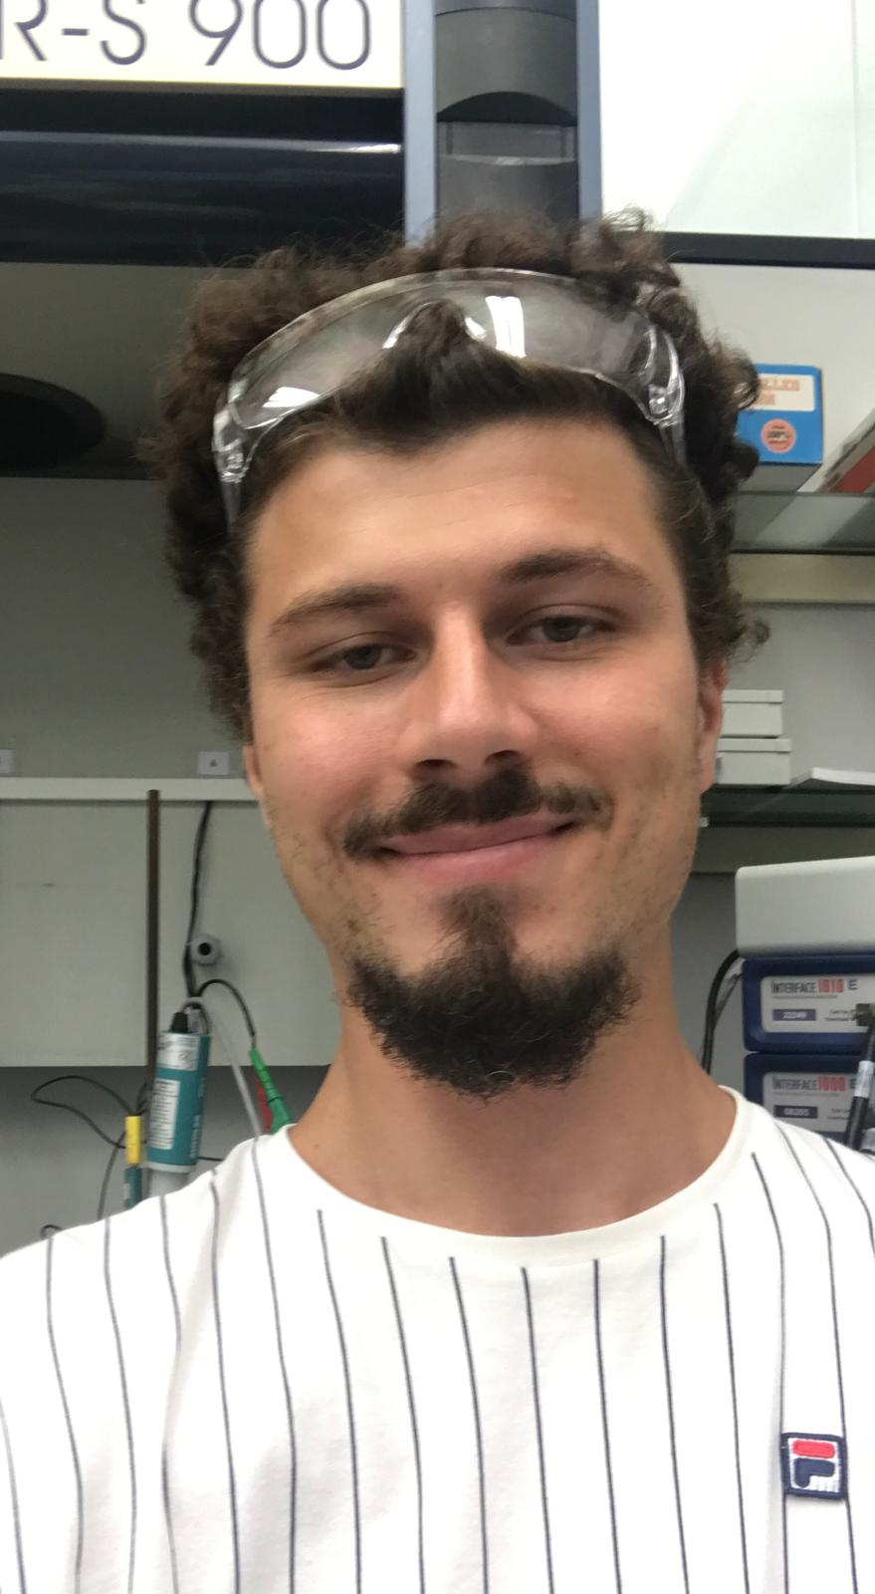
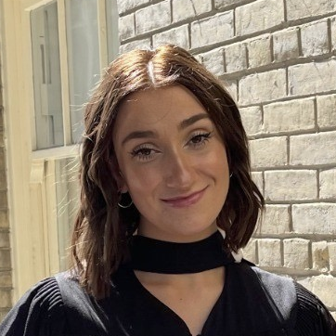
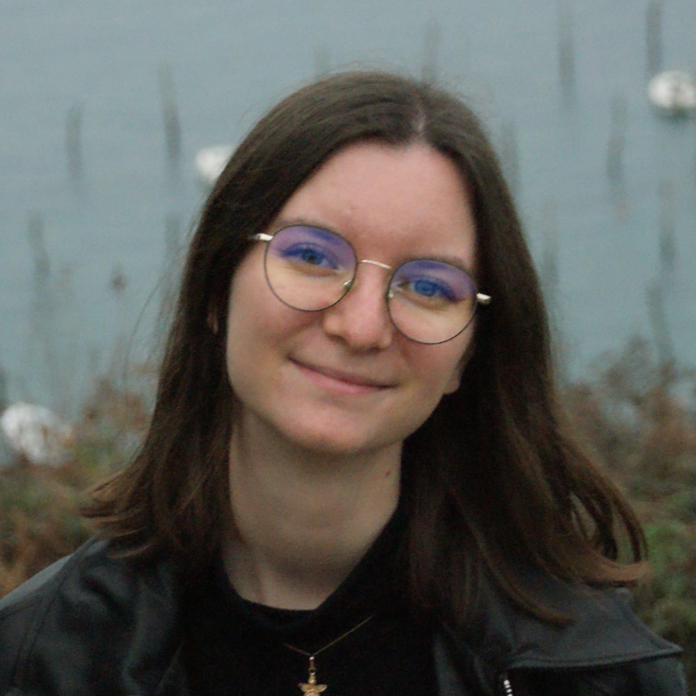
Microfluidic, Emulsion and Biology
PI: Abdou Rachid Thiam, DR CNRS
Indicate in which axis your team relates to:
Mohyeddine OMRANE research engineer
Jennica Trager Post-Doc
Mehdi Zouiouich Post-Doc
Helin Elhan PhD candidate
Lisa Kauffmann PhD candidate
Sami Kchir PhD student
Murphy Mc Dermott PhD student
Bleuenn Feuillet PhD student
Axis 1: Controlling and programming biological living matter.
Axis 2: Emergence of spatial and temporal organization in living matter.
Axis 3: Information processing and dynamics of biological active matter.
Axis 4: Driving evolution within living systems.
Question of Interest and/or Collaboration wanted:
Team expertise:
Giant Organelles Vesicles.
In-vitro cellular membranes physical properties measurements.
In-vitro model of lipid droplet nucleation.
In vitro study of protein–bilayer/monolayer interactions
Biochemical analysis of cellular lipid droplets/ER membranes
Cell biology and biophysics of lipid droplets and the endoplasmic reticulum.
Impact of lipid droplet composition on protein binding through amphipathic helices.
Impact of proteins and neutral lipids on lipid droplet nucleation process.
Organelles contact sites and lipid transfer mechanism.
Autophagic degradation of lipid droplets.

